Slide 1
FADS1 and FADS2

Slide 2
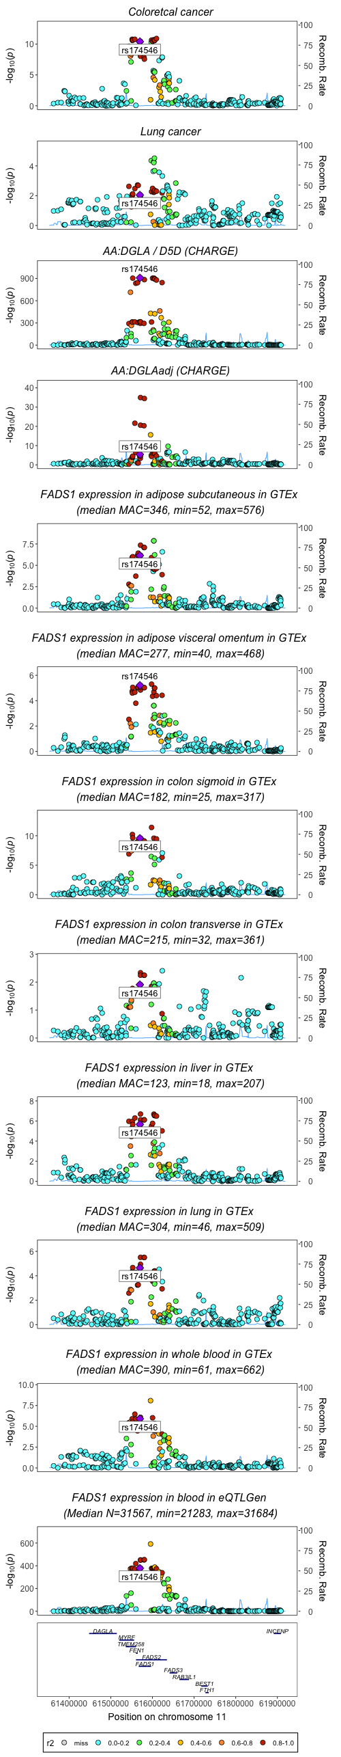
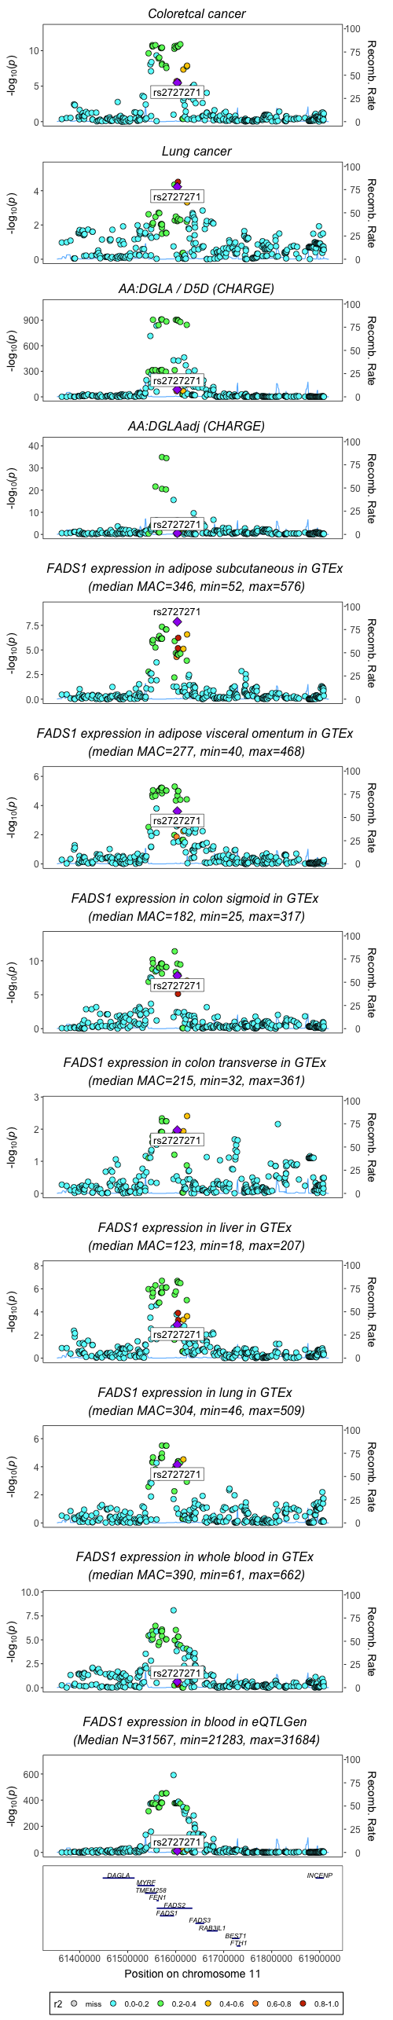
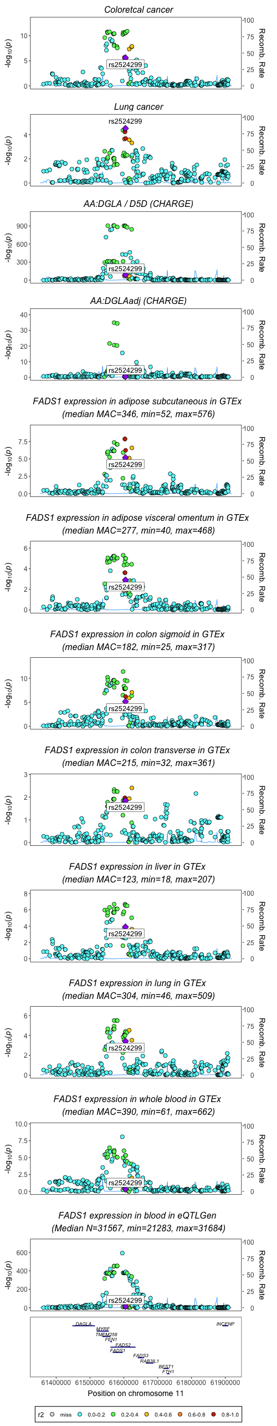
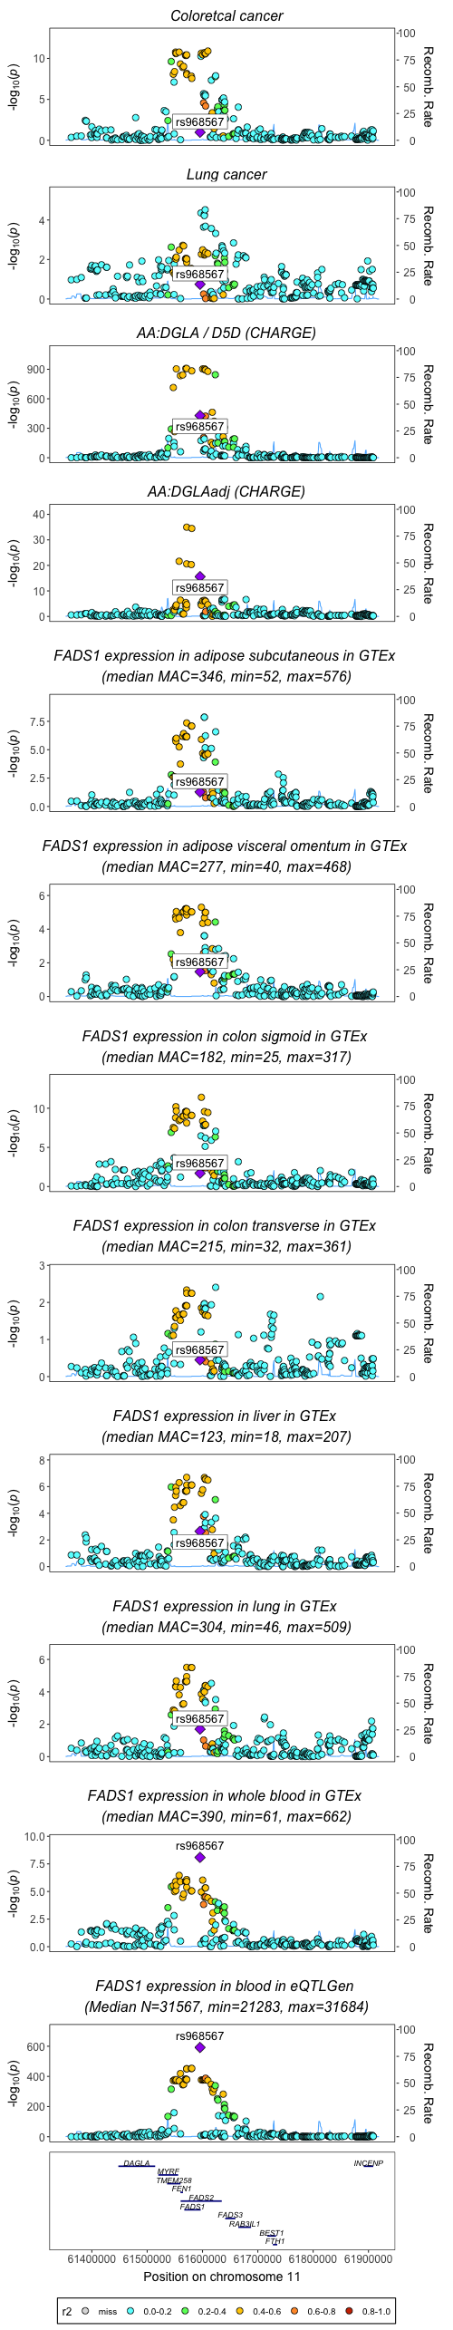
Position of rs174546, rs2524299 and rs968567 in associations for FADS1 activity/expression and cancer
(non imputed data for fatty acids from CHARGE)
R2=0.929 rs2524299 and rs2727271

Slide 3
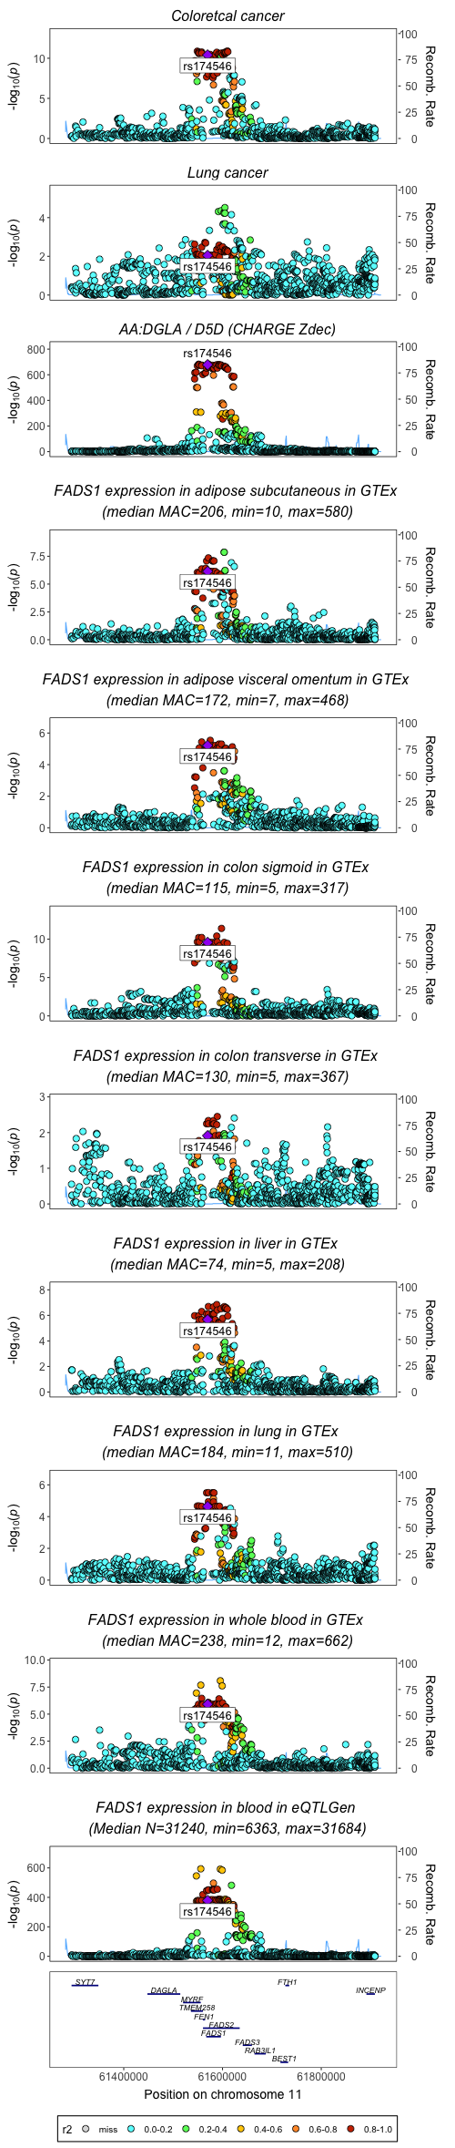
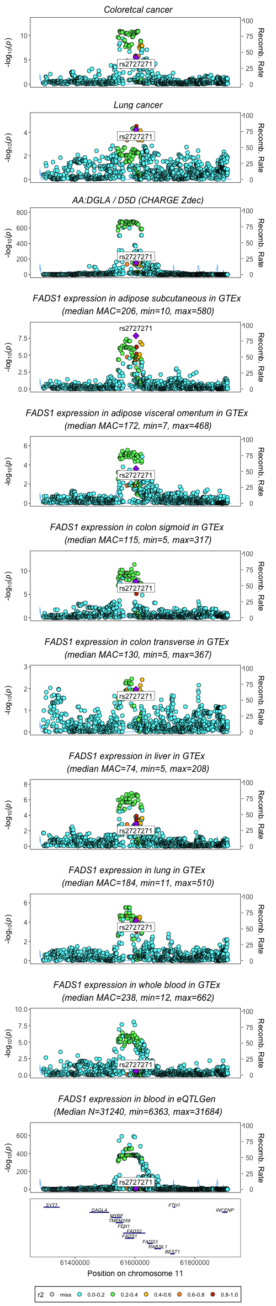
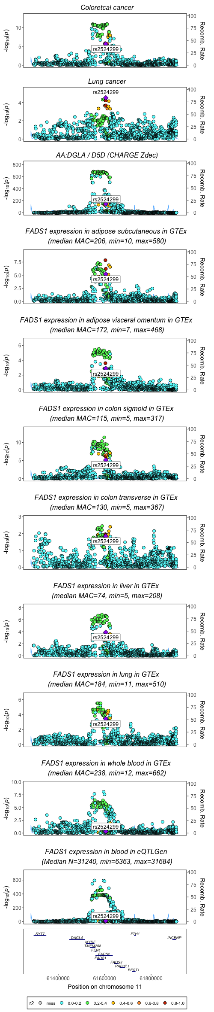
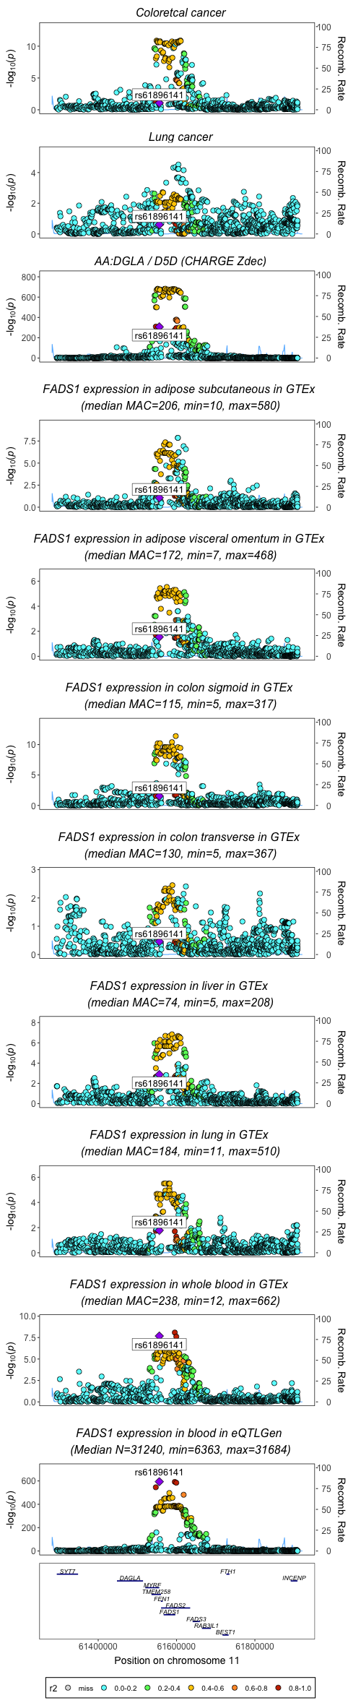
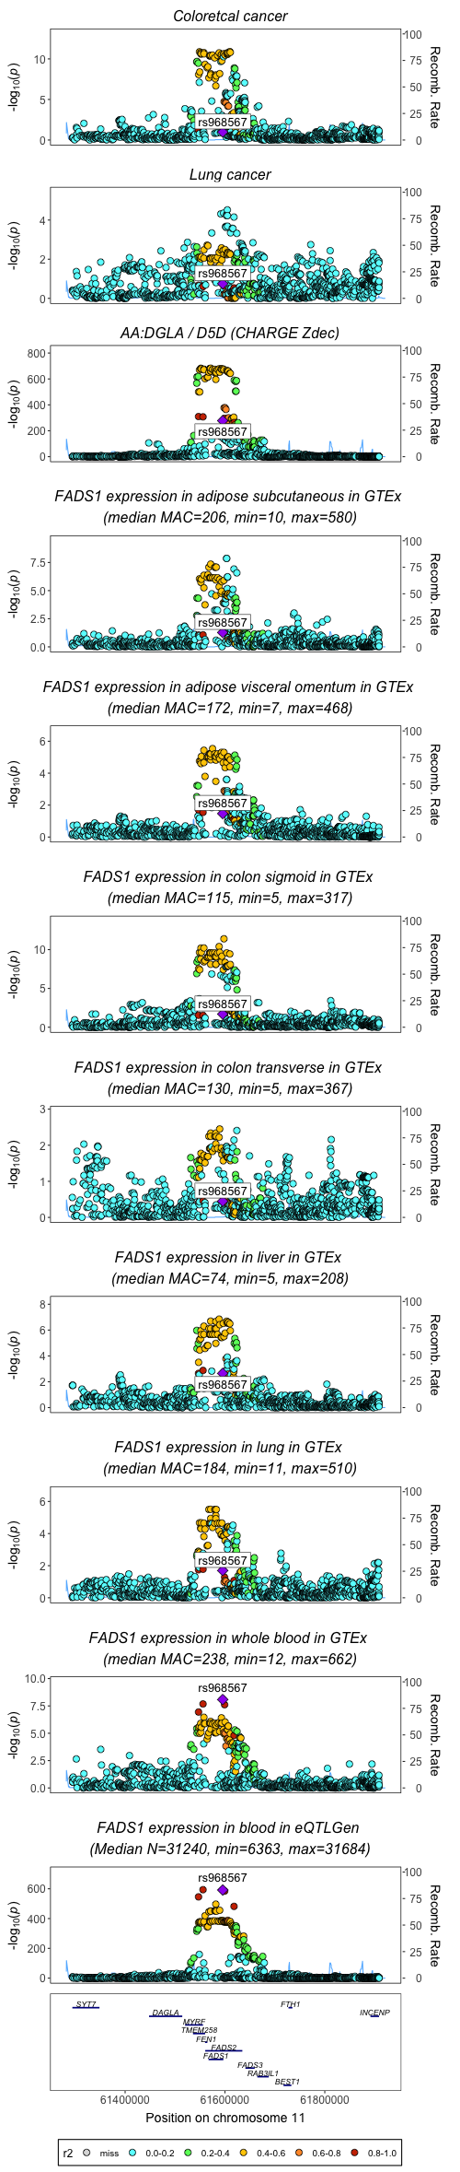
Position of rs174546, rs2524299, rs968567 in associations for FADS1 activity/expression and cancer
(imputed dataset for fatty acids from CHARGE)
R2=0.929 rs2524299 and rs2727271
R2= 0.981 rs968567 and rs61896141

Slide 4
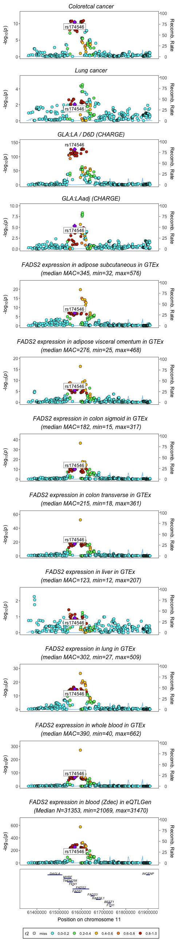
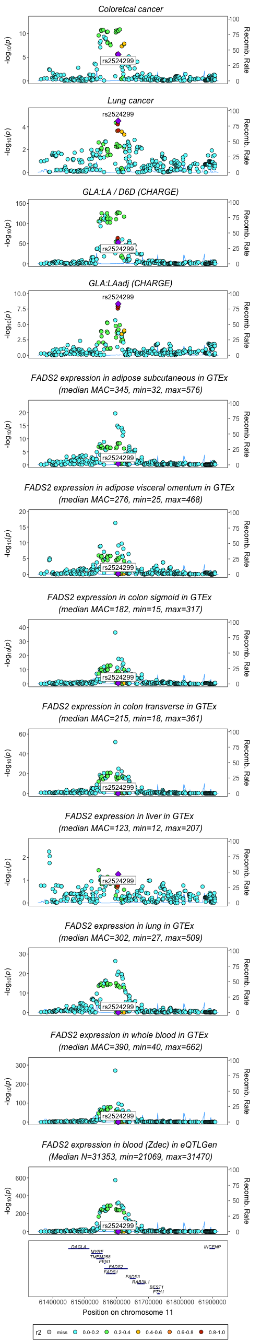
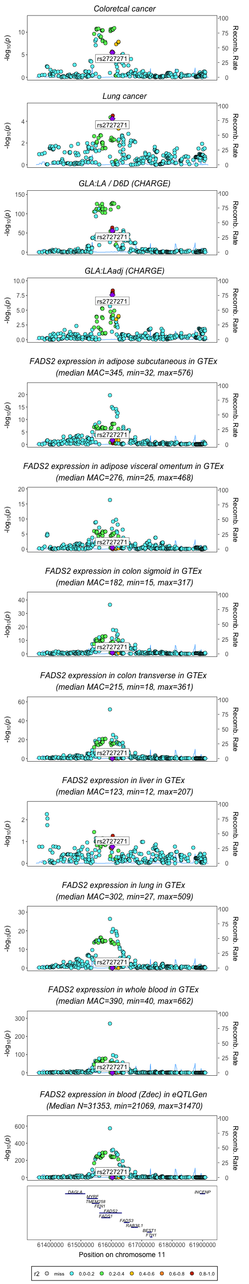
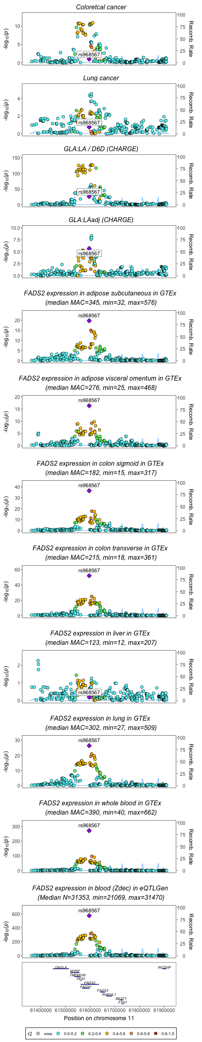
Position of rs174546, rs2524299, rs968567 in associations for FADS2 activity/expression and cancer
(non imputed data for fatty acids from CHARGE)
R2=0.929 rs2524299 and rs2727271

Slide 5
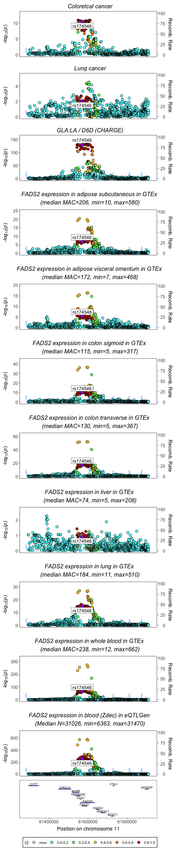
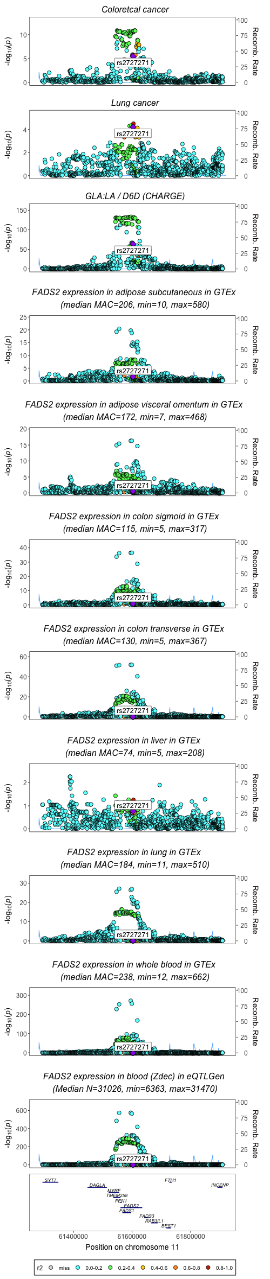
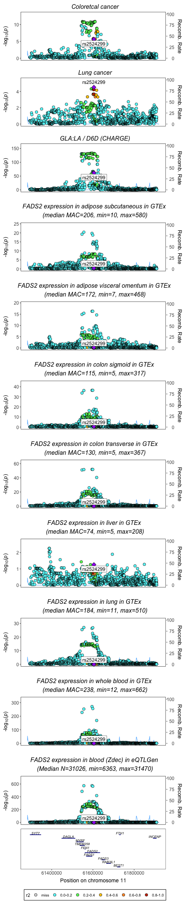
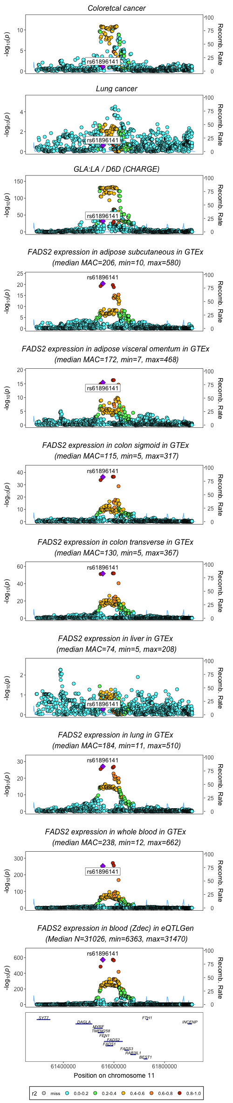
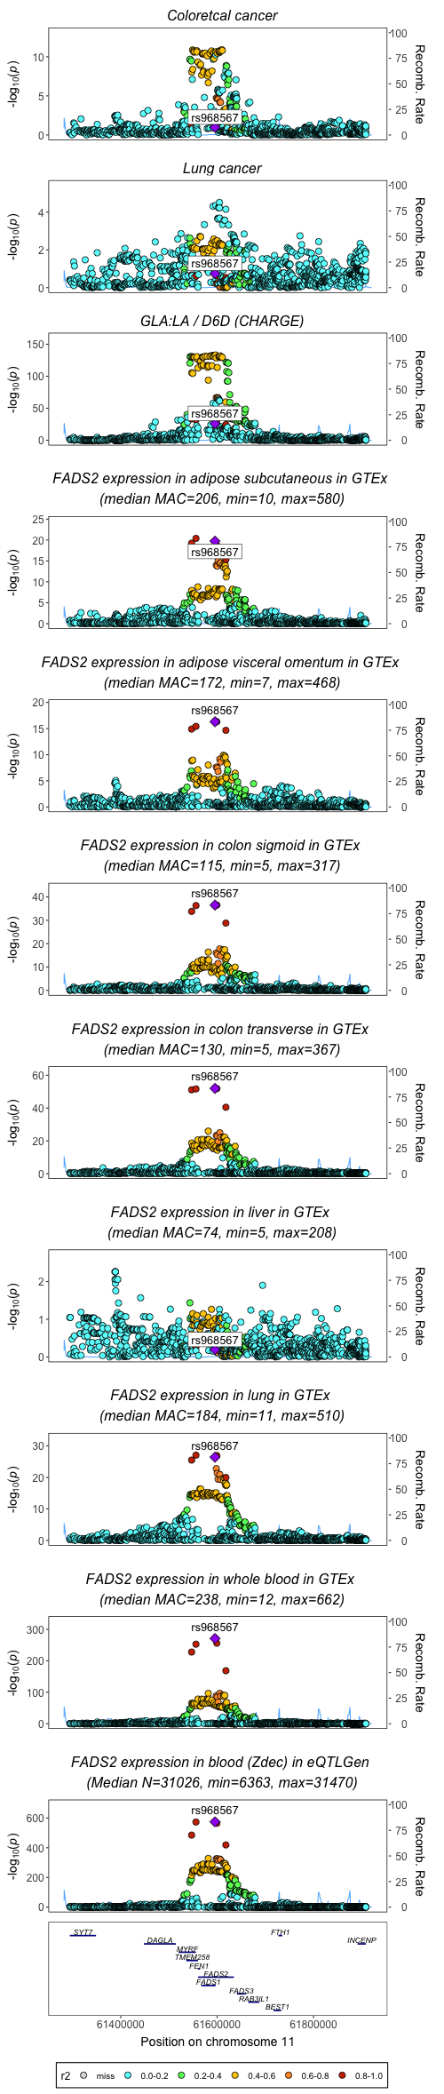
Position of rs174546, rs2524299, rs968567 in associations for FADS2 activity/expression and cancer
(imputed dataset for fatty acids from CHARGE)
R2=0.929 rs2524299 and rs2727271
R2= 0.981 rs968567 and rs61896141

Slide 6
FADS3

Slide 7
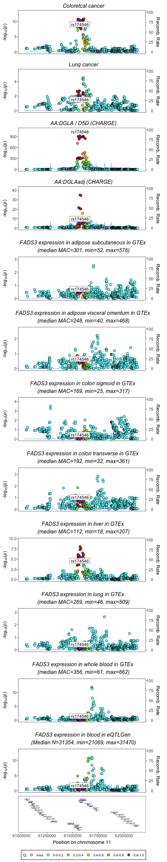
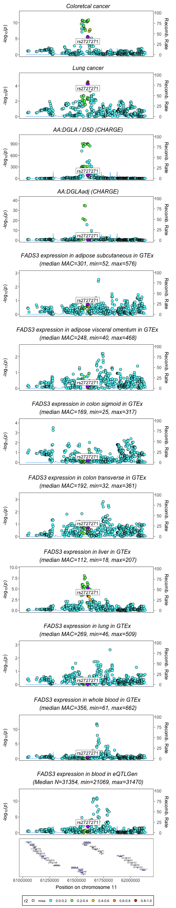
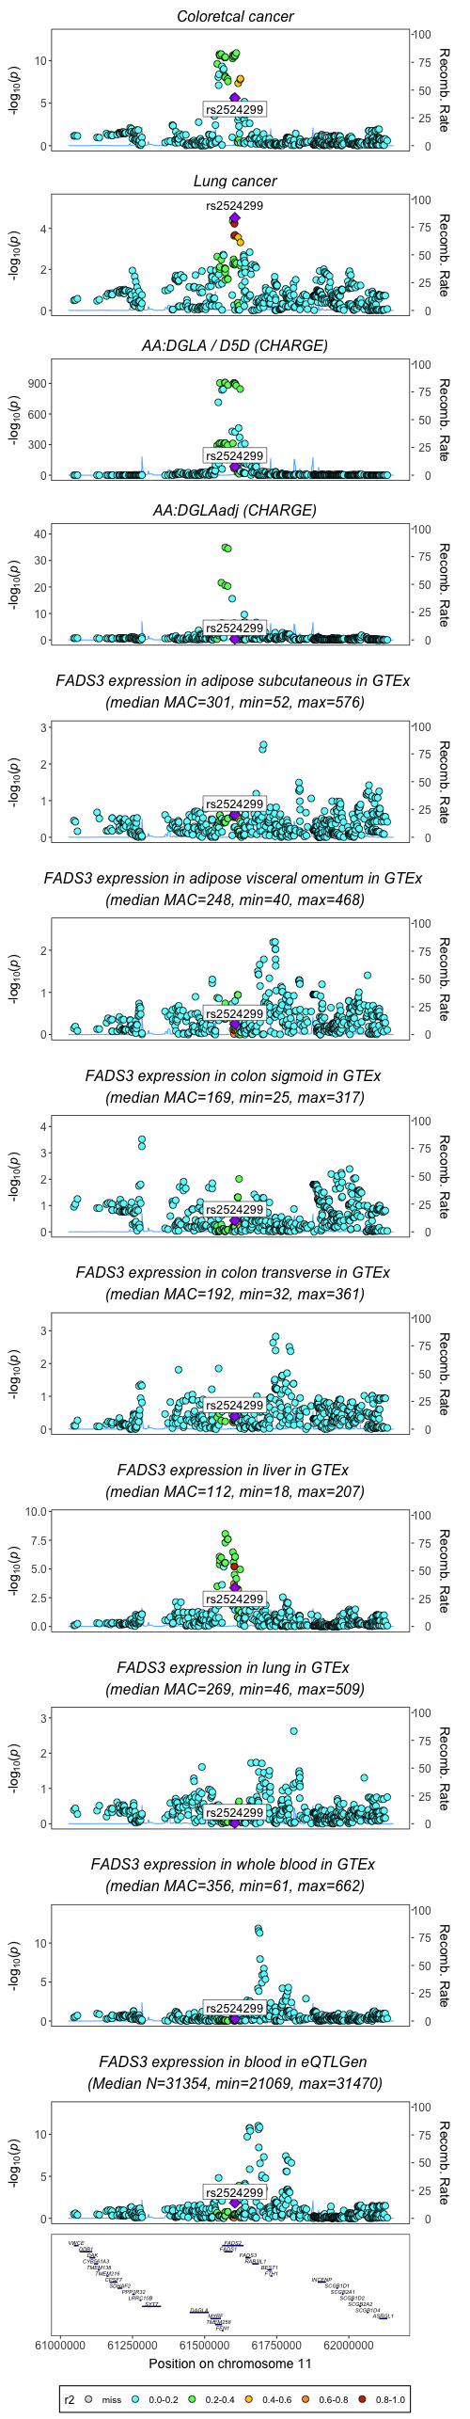
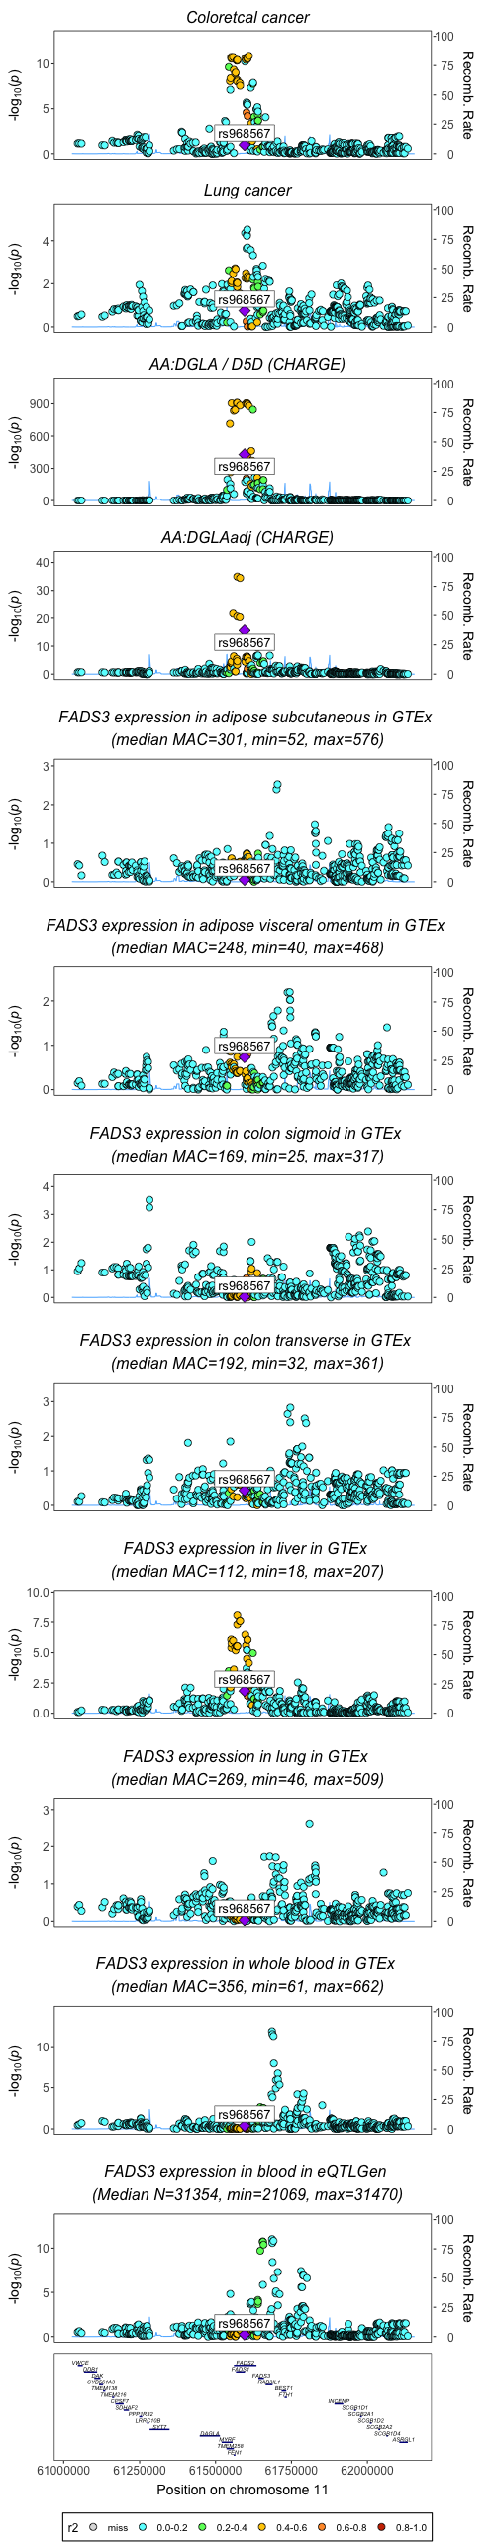
Position of rs174546, rs2524299 and rs968567 in associations for FADS3 activity/expression and cancer
(non imputed data for fatty acids from CHARGE)
R2=0.929 rs2524299 and rs2727271

Slide 8
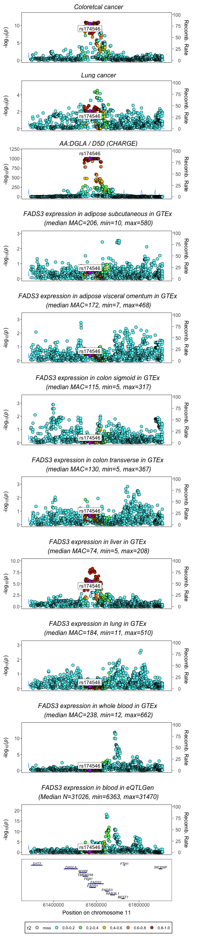
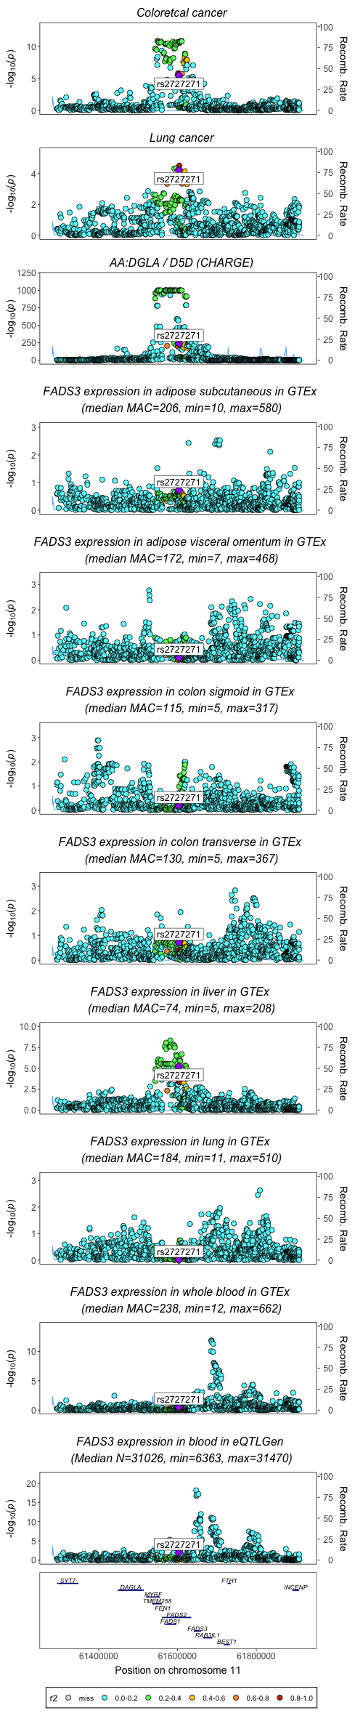
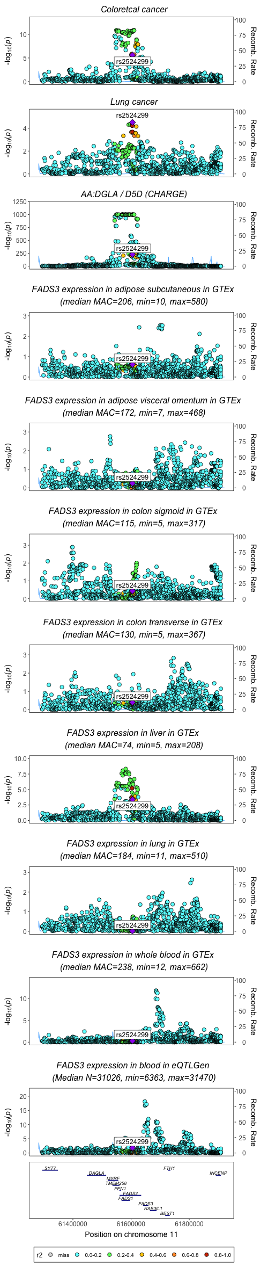
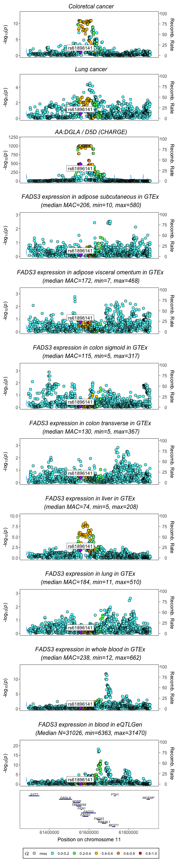
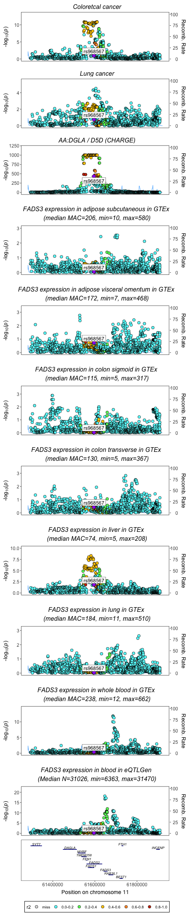
Position of rs174546, rs2524299, rs968567 in associations for FADS3 activity/expression and cancer
(imputed dataset for fatty acids from CHARGE)
R2=0.929 rs2524299 and rs2727271
R2= 0.981 rs968567 and rs61896141

Slide 9
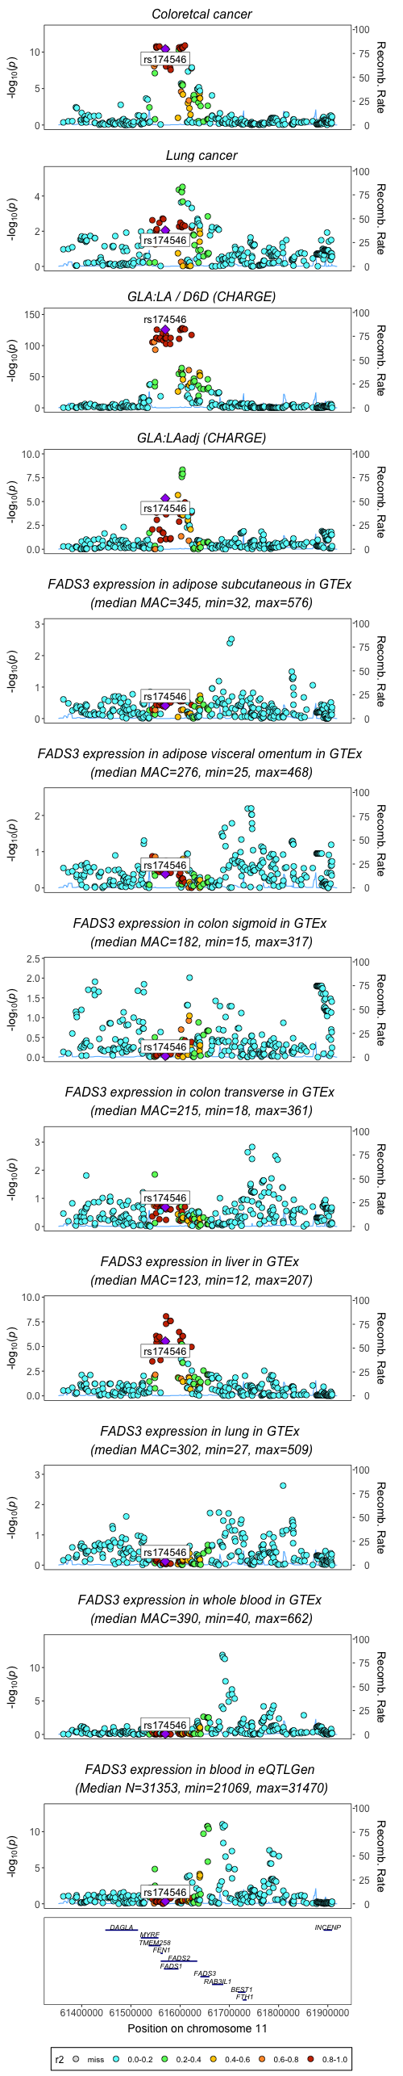
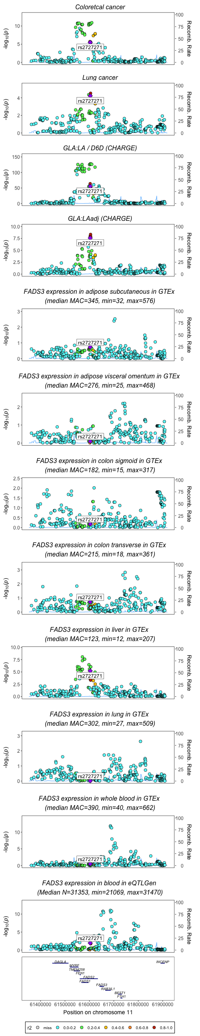
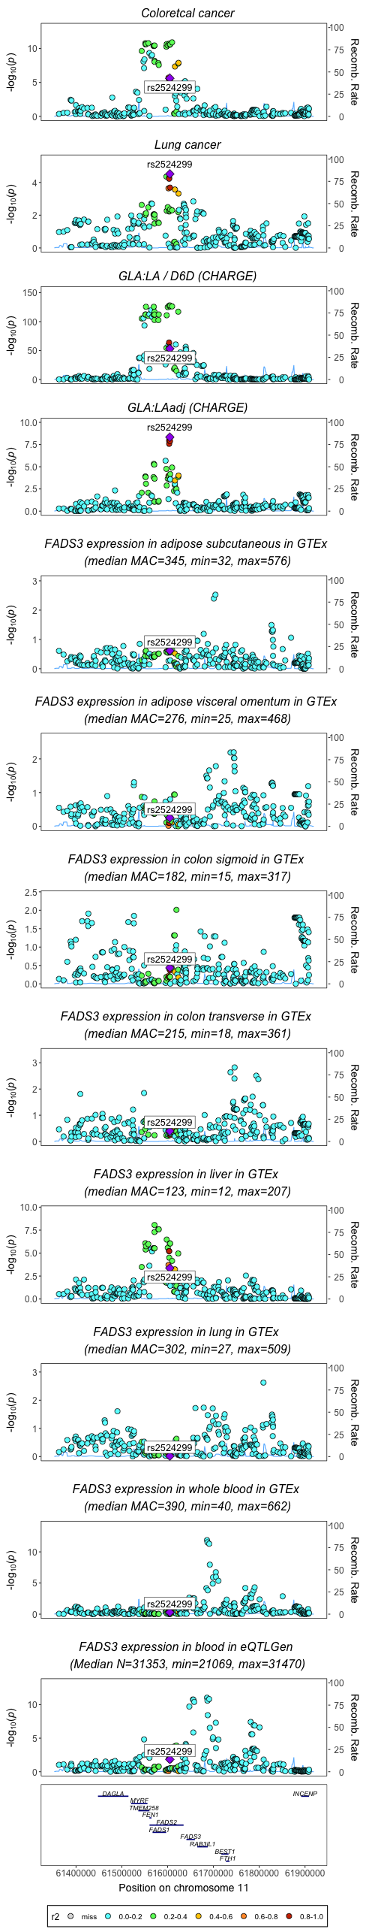
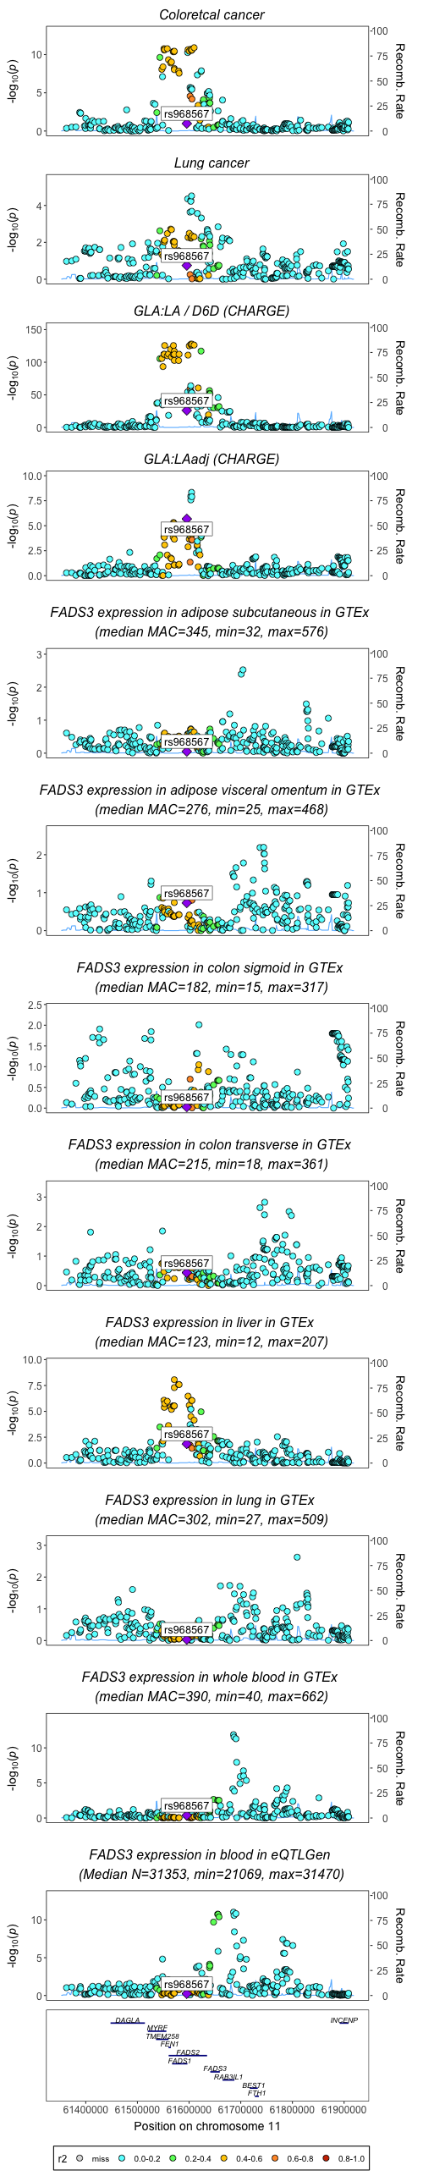
Position of rs174546, rs2524299, rs968567 in associations for FADS3 activity/expression and cancer
(non imputed data for fatty acids from CHARGE)
R2=0.929 rs2524299 and rs2727271

Slide 10
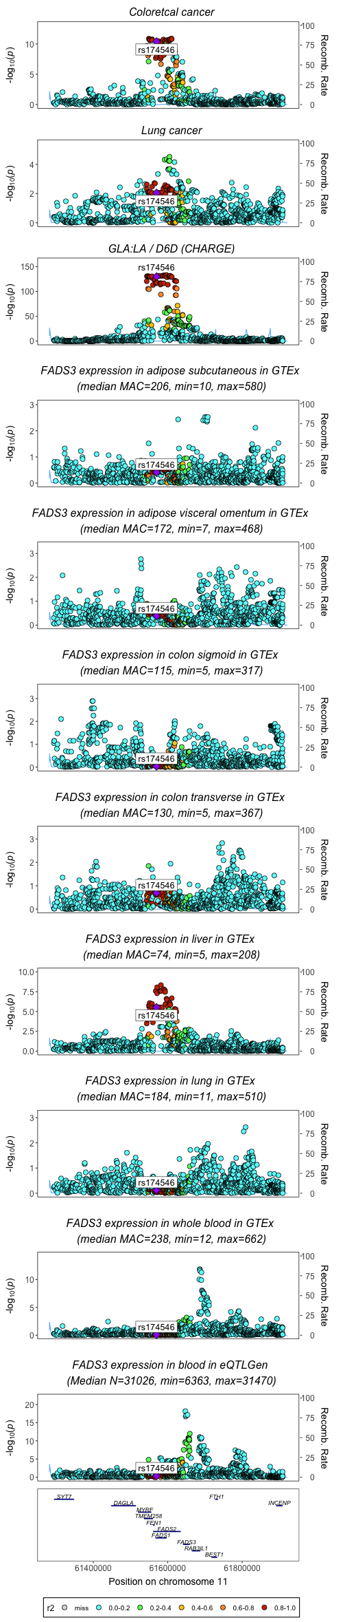
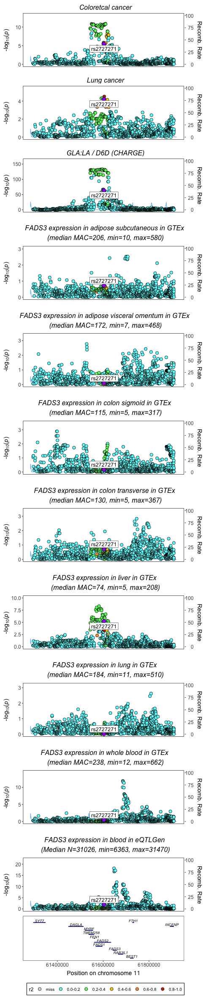



Position of rs174546, rs2524299, rs968567 in associations for FADS3 activity/expression and cancer
(imputed dataset for fatty acids from CHARGE)
R2=0.929 rs2524299 and rs2727271
R2= 0.981 rs968567 and rs61896141

Slide 11
